Slide 1

Machine Learning Prediction of Foodborne Disease Pathogens:
Algorithm Development and Validation Study

Slide 2
Abstract
Background: Foodborne diseases have significant health and economic impacts, primarily driven by foodborne pathogens. Despite their importance, clinical symptoms lack specificity, and actual pathogen detection is infrequent in practice.
Objective: The main objective is, the author analyzes foodborne disease case data, select appropriate features and use machine learning methods to classify and predict the foodborne disease pathogens for cases where it is not tested.
Methods: Extracted features like time, location and food types from foodborne disease case data and looked into the relationship between features and disease pathogen using machine learning methods to classify them. And compared the results of models to obtain pathogen prediction model with highest accuracy.
Results: It is observed that gradient boost decision tree model obtained highest accuracy with 69 % in identifying pathogens like Salmonella, Norovirus, Escherichia coli, and Vibrio parahaemolyticus. Evaluation of features like time of illness, geographical coordinates, and diarrhea frequency, implied that these features are significant in classifying foodborne disease pathogens.
Conclusions: Data analysis can reflect the distribution of some features of foodborne diseases and the relationships among them. Utilizing this information and machine learning methods for pathogen classification can offer valuable support for clinical diagnosis and treatment of foodborne diseases.

Slide 3
Introduction:
Background:
Foodborne diseases are usually caused by taking contaminated foods and pathogens or virus contained in it.
According to WHO, Every year 600 million suffer from foodborne diseases out of which 4.2 million people die.
As per CDC, 48 million people are infected in the US every year in which 128,000 are hospitalised and 3000 die.
Recently, China began to monitor this and found that 3 lakh people suffered from it ,out of which 6 died.
Researchers then started to study these that includes monitoring, identification and outbreak prediction.
As a result, US established Active Surveillance Network and China established National Foodborne Disease Surveillance Reporting System to store, monitor and analyze surveillance data collected nationwide.
Methods for identification and diagnosis are categorized into 2 types. One is biochemical tests of molecular subtypes and other uses machine learning algorithms.
Although some clinical trails and laboratory testing was done to identify pathogens, the results were not clear as it needs to be applied on each patient information and disease description.
Some researchers proposed several methods like nucleic acid, immune and biosensors. But it was carried for low proportion of data as the equipment cost is high. This has a negative effect on disease burden estimation and outbreak prediction.

Slide 4
Related Work:
Foodborne Disease Analysis Based on Surveillance Platform Data
International community gave great importance to research on Foodborne diseases. They have taken data sources from surveillance platforms, social networks, search engines and food samplings.
But found that, the data from surveillance network was reliable and authoriative as it is the original data taken from hospital and health departments.
As mentioned earlier US and China governments established reporting systems and performed statistical and aggregate analysis that was not proved to detect pathogens because of its limitations. Therefore accurate identification approach is still necessary.
Foodborne disease Analysis Based on Machine Learning
Machine Learning gained popularity in various field including Epidemiology in recent years. Researchers proposed many ML models to diagnose and outbreak and analyze gene of disease pathogens.
For identification of diseases many chose supervised classification and unsupervised clustering methods and for outbreak prediction hidden Markov model and DB scan models are used instead of traditional and proved that these studies gave good results.
Several classifications models identified pathogens by using near infrared laser scatter images. ML is used in gene sequence that results in more and quicker analysis. Decision tree was also used to associate between food, location and pathogens based on CDC data.
Out of most related works, only few were applied on disease case information and binded relation between pathogens and disease case data.

Slide 5
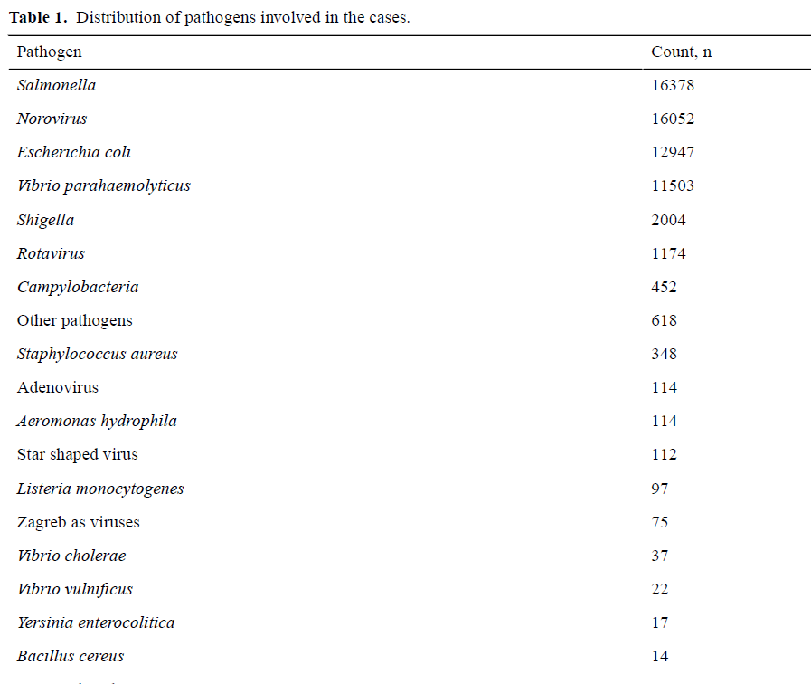
Methods:
Data Description:
The data source was National Foodborne Disease Surveillance Reporting System that collected 2.6 million cases from 2011-2018. 60,000 test cases accounted only 3% cases. A total 26 of pathogens were identified.
Among them, China Food safety risk assesment center focused on Salmonella, Norovirus, Escherichia coli, Vibrio parahaemoolyticus (26.5%, 25.9%, 20.9%,18.6%) accounts 92% of cases.
Considered pathogens as labels and as a process of feature selection, Patient age, Gender, Home address, time of illness, symptoms, food name and food type. Performed data analysis and guide data preprocessing. They used map to show geographical distribution of detection rate of 4 pathogens.
The author performed visual analysis of detection rate pathogens by time, patient’s age, gender and type of exposed food which can be seen by going down.

Slide 6
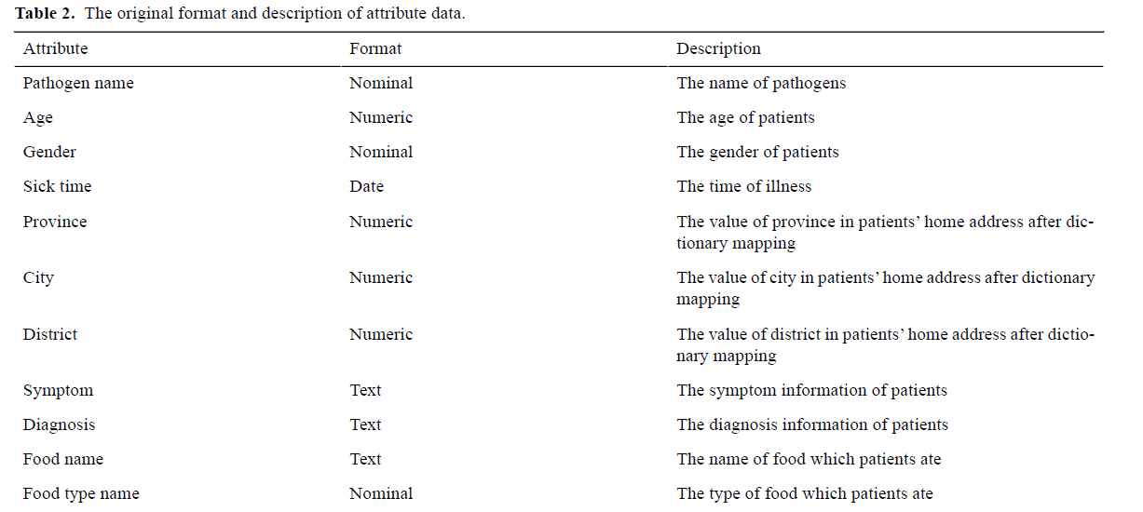
Data Preprocessing:
Taken the 4 pathogens as labels. The gender data in nominal format is converted into a binary variable, and extracted the month value from the time of illness as a time attribute. For the age attribute, they used 10-year intervals. Home address was converted into latitude and longitude as location attributes.

Slide 7
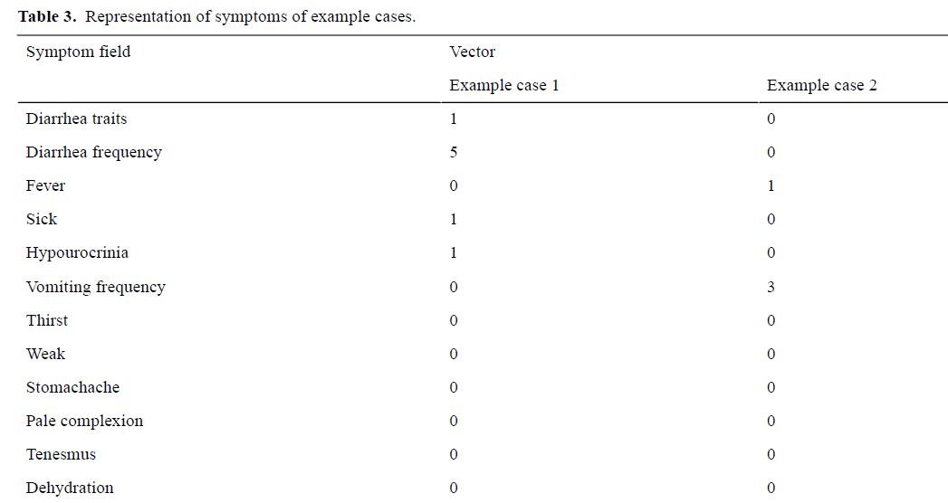
Symptoms field in word segmentation divided into different symptoms. For diarrhea trait and frequency, it was assigned with a corresponding values in the dictionary. Similarly, for the vomiting symptom it was taken as vomiting frequency. And for remaining symptoms they set to threshold value and converted to binary variables.

Slide 8
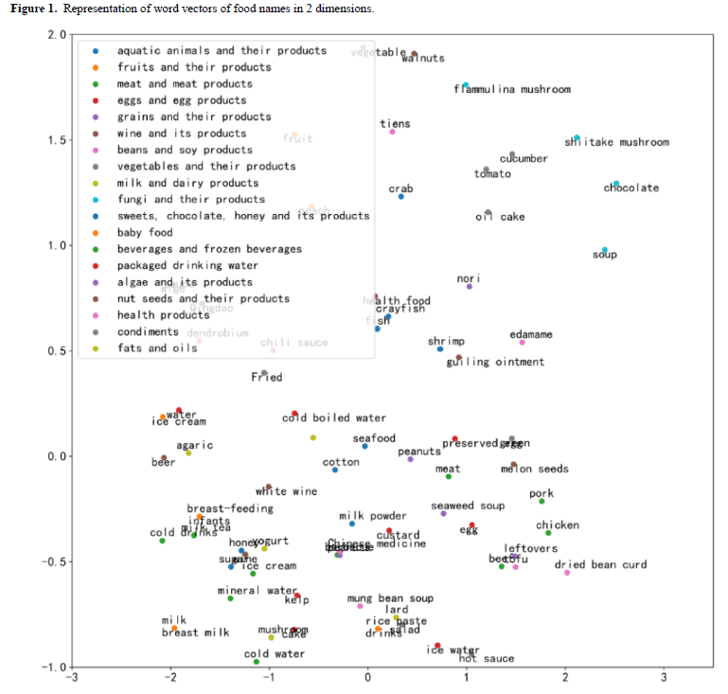
Then the exposed food information contains food type and name. it consists of 19 food categories . Using word2vec an approach of N-gram language model , the food name text data can find vectors. To equal this, they found mean of all food names and used 300 dimension space vector. Using t-distributed stochostaic embedding method, to plot top 5 foods in to 2 dimension vector that can reduce the time for training the model. Total 349 dimension vector was used.

Slide 9
Classification Methods:
Decision tree, Random forest, Gradient Boost decision tree and Adaptive Boosting are the models that are used here.
Decision tree:
It is a non-parametric supervised learning method used in classification and regression.
It puts all features in the classifier at once and then decomposes the complex-making process into recursive steps, dividing the features.
It does not need data normalization.
Random Forest:
It is an ensemble model based on decision trees that can solve problem of weak generalizability.
It builds multiple decision trees and uses replacement method to train data.
It can process high dimensional data without feature selection and errors can be balanced for unbalanced data.
However, it may be overfitted for noisy datasets.
GBDT:
It is integrated model based on decision trees. Unlike random forest, which uses bagging to randomly select samples, GBDT uses the boosting method; it uses a serial training method to add the results of weak classifiers to obtain the prediction value.
When training the next weak classifier, it fits the residual between the predicted value of the previous round of classifiers and the true value to improve the classification result.

Slide 10
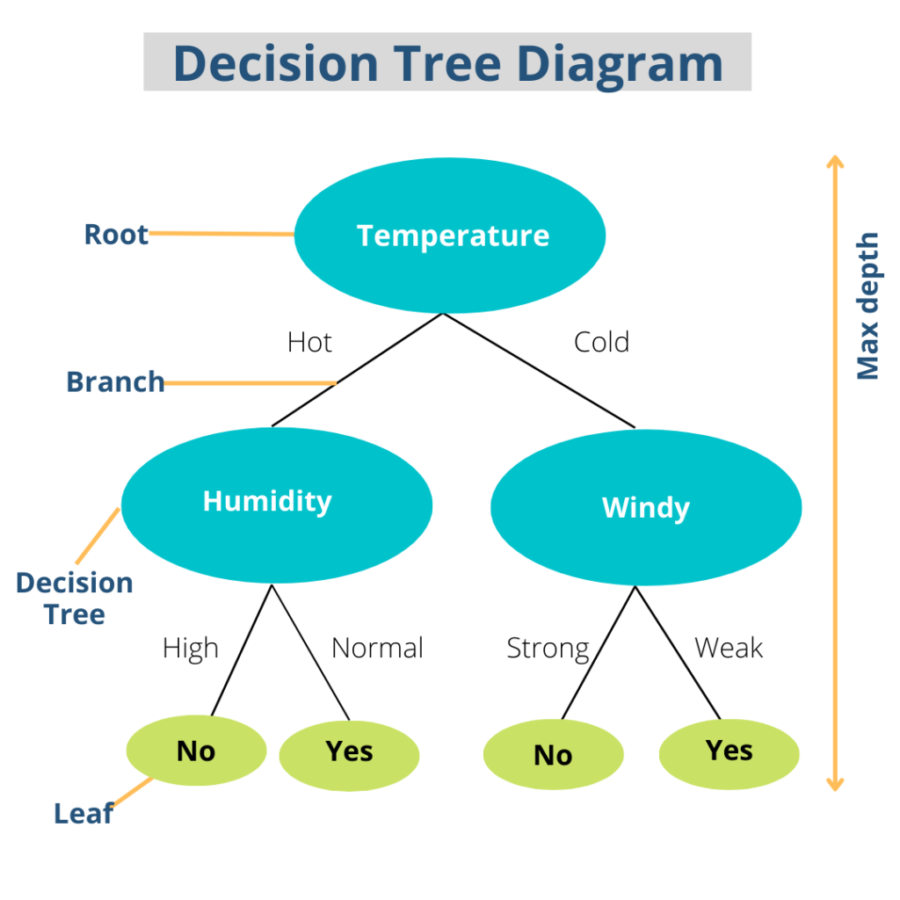
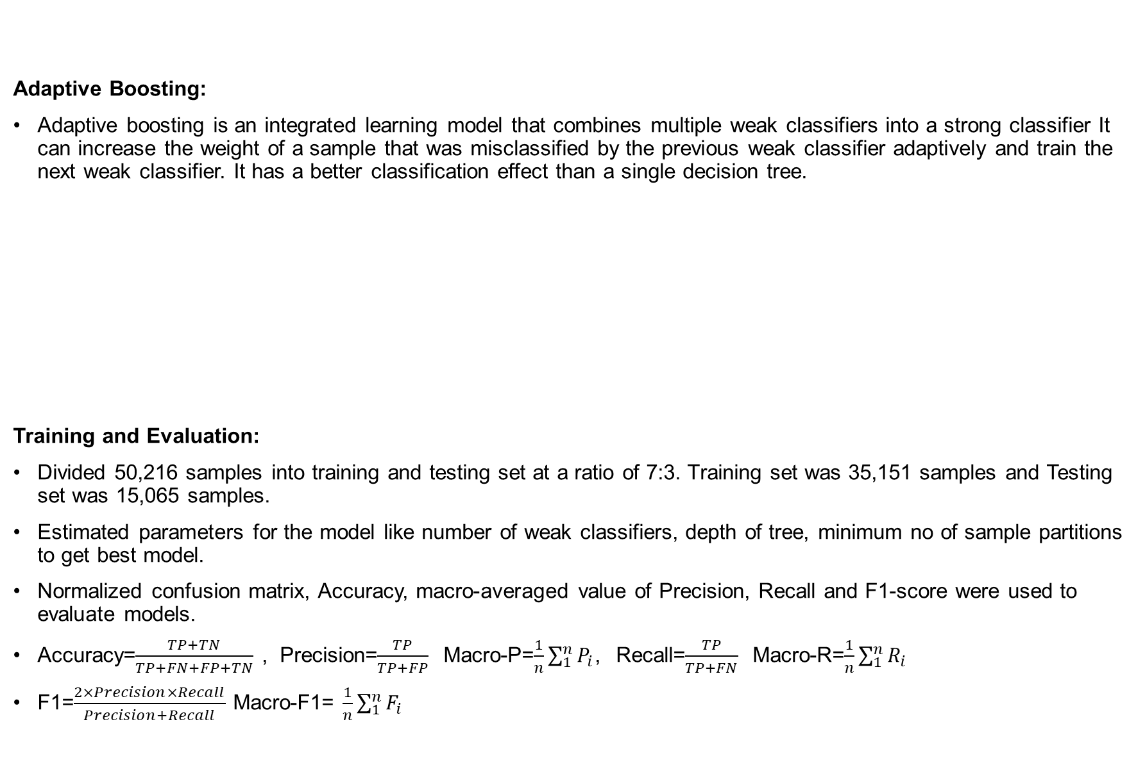
Adaptive Boosting:
Adaptive boosting is an integrated learning model that combines multiple weak classifiers into a strong classifier It can increase the weight of a sample that was misclassified by the previous weak classifier adaptively and train the next weak classifier. It has a better classification effect than a single decision tree.
Training and Evaluation:
Divided 50,216 samples into training and testing set at a ratio of 7:3. Training set was 35,151 samples and Testing set was 15,065 samples.
Estimated parameters for the model like number of weak classifiers, depth of tree, minimum no of sample partitions to get best model.
Normalized confusion matrix, Accuracy, macro-averaged value of Precision, Recall and F1-score were used to evaluate models.
Accuracy=$\frac{TP+TN}{TP+FN+FP+TN}$ , Precision=$\frac{TP}{TP+FP}$ Macro-P=$\frac{1}{n}\sum_{1}^{n}{P_{i}}$, Recall=$\frac{TP}{TP+FN}$ Macro-R=$\frac{1}{n}\sum_{1}^{n}{R_{i}}$
F1=$\frac{2×Precision×Recall}{Precision+Recall}$ Macro-F1= $\frac{1}{n}\sum_{1}^{n}{F_{i}}$

Slide 11
Feature Importance Evaluation:
In order to understand which features have a more important impact in the classification process, they calculated the importance value of each feature. Since all the models were based on tree structures, Gini importance is used to calculate the importance of features.
Gini importance is the degree to which the Gini index of a branch node formed by M is calculated for a feature.
For the entire model, the average value of the Gini index of the feature on all trees is calculated.
Results:
Data Analysis:
Geographical distribution of detection rate of pathogens can be seen below. It can observed that it is somewhat distinguishable.
According to detection rate of pathogen in different months is shown in upper left, there are some differences are among pathogens in seasons. For example, Vparahaemolyticus occurs more frequently in summer, while Norovirus occurs more frequently in autumn and winter.
The age distribution of patients infected with E. coli, Salmonella, and Norovirus shows a concentration in the 0-10 years age group, while patients with V. parahaemolyticus infections were typically between 20 and 40 years old, indicating a distinct age pattern for this pathogen compared to the others.
The bottom left of Figure 3 shows the gender distribution and the bottom right of Figure 3 shows the distribution of 4 pathogens in 23 food categories. These analysis results show the difference among 4 pathogens.

Slide 12
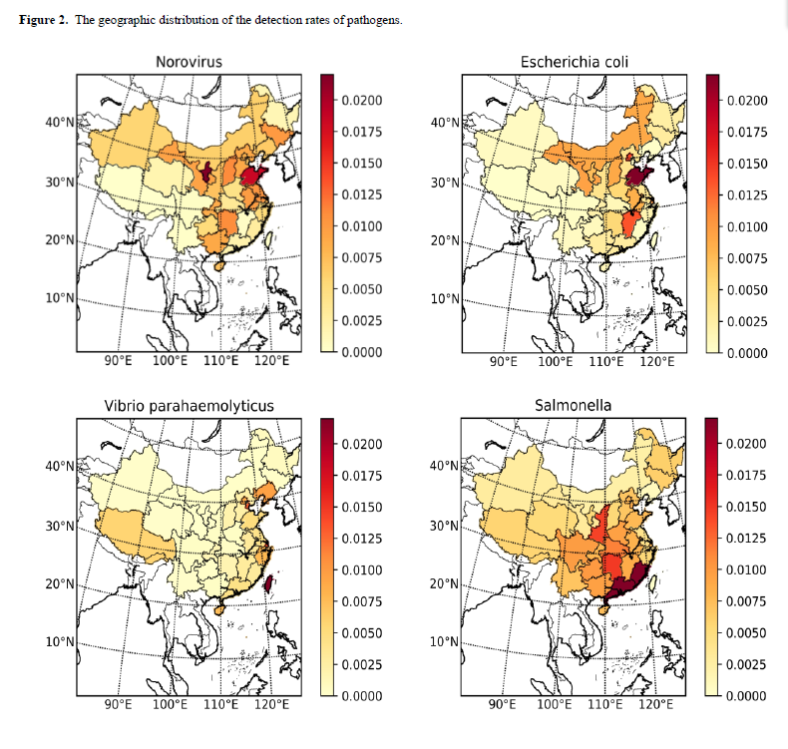

Slide 13
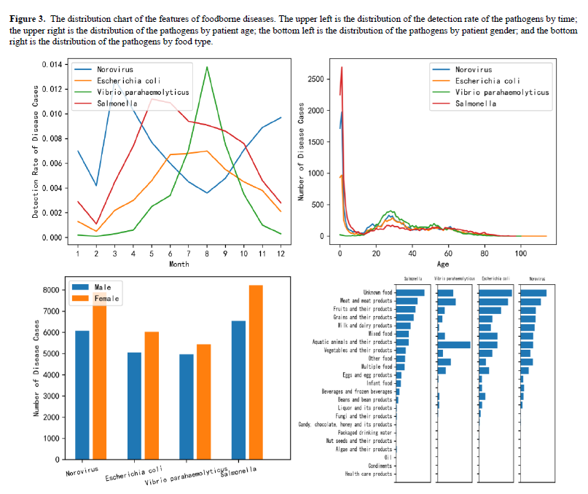

Slide 14
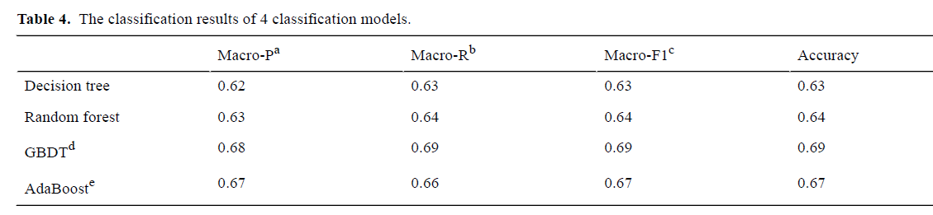
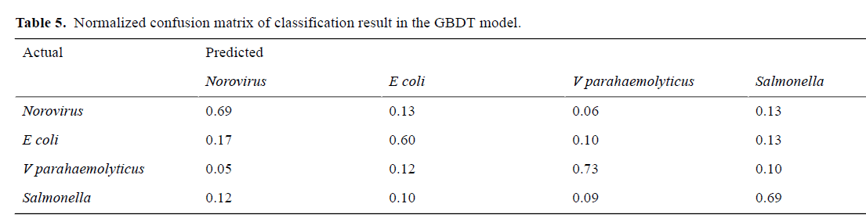
Classification Results:
From the results, it is observed that decision tree model performance was least. It’s accuracy, macro-P, macro-R, macro-F1 were 63%.
For Random Forest it is better than single decision tree but accounts for only 1% higher than decision tree(64%)
GBDT model gave 69% accuracy which was better than the above 2 models . (weak classifier: 171; depth of the tree: 20; minimum number of sample partitions: 50)
Adaptive boosting reached an accuracy of 67% but lower than GDBT.
Similarly, the confusion matrix values of GDBT classification recalls of the 4 pathogens (Norovirus, E coli,V parahaemolyticus, Salmonella) were 69%, 60%, 73%, and 69%, respectively.

Slide 15
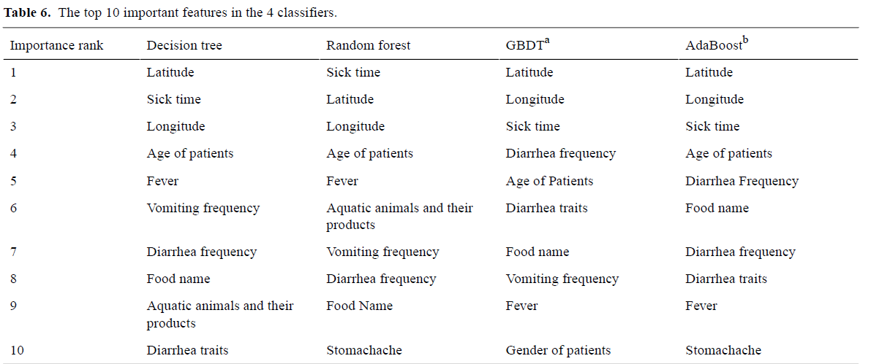
Feature Importance Evaluation:
According to Table 6, we can see that the 4 classifiers have higher feature importance values in the longitude and latitude of the geographical location, the time of illness, the age of patient, the name of food, and certain symptoms (such as fever, frequency of diarrhea, frequency of vomiting).
This means that these attributes have a great influence on the discrimination of pathogens. In addition, GBDT, decision tree, and AdaBoost also have relatively high importance value on diarrhea traits, and the stomachache symptom has a high impact on the classification process of the AdaBoost model and the random forest model.
In the food types, aquatic animals and their products had a high impact on the classification process using decision tree or random forest. Combined with the previous exploratory analysis of data distribution, we can find that the attributes with large differences in data distribution have larger attribute importance values too.

Slide 16
Final Discussion:
Contribution:
Proposed a ML model to detect pathogens without laboratory testing. Found relationship between pathogens and several features of disease cases.
This approach can help doctors to quickly identify pathogens, if there is no sufficient equipment and budget. This in turn can help doctors to give medical treatment and provide support for more accurate diseases.
Limitations:
The disease case data from surveillance platform should be merged with social network or search engine data in order to apply ML models on larger data.
Geographical distribution of pathogens may be affected by population size. So incidence may be differed.
Conclusions:
Presented a optimal ML model for detection of pathogens with an accuracy of 69%.
Although it cannot replace traditional laboratory testing, it can be used to assist for identifying with little cost and time.
In future, compare the results with the data of outbreak surveillance system and try to add other domain knowledge to get reliable results.

Slide 17
Thank You

